Slide 1

Making the most of school-based collaboration
Reed Senter, M.S. CCC-SLP
University of Maryland, College Park

Slide 2
Disclosures
I currently serve as the Vice President for Governmental and Political Affairs of SHAV. As a board member, the association has waived my conference registration fee.
I have no other financial or non-financial disclosures.

Slide 3
What isn’t collaboration?
It’s not a service delivery model.
It’s not a “coaching” relationship.
It’s not something the admins are making you do.

Slide 4
So what is collaboration?
“A partnership between professionals, working together to achieve common goals.”
Cooperation
Coordination
Cross-fertilization
Integration

Slide 5
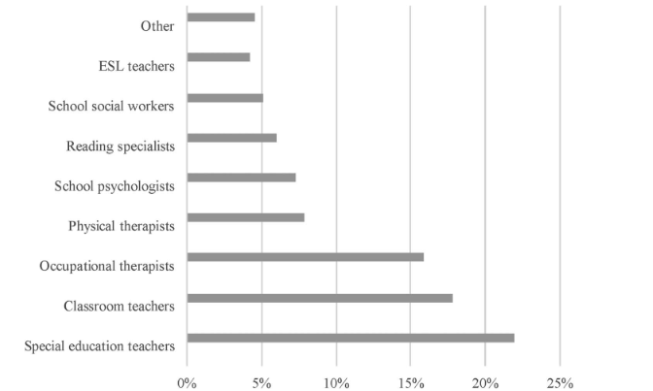
With whom do slps collaborate?
Pfeiffer et al., 2019

Slide 6
On what can SLPs collaborate?
Vocabulary: 6 studies, strong evidence supporting SLP-educator classroom collaboration
Oral language: 5 studies, overall benefit to narrative language, but specific expressive language goals may benefit more from small group/individual tx followed by classroom support
Phonological awareness: 4 studies, strong evidence for benefits of classroom collaboration
Curriculum-based language: 8 studies, findings suggest SLP-educator collaboration may be necessary to achieve high quality language and literacy instruction
Writing: 2 studies, positive results
Archibald, 2017

Slide 7
Cooperation
Individuals working together on a joint task.

Slide 8
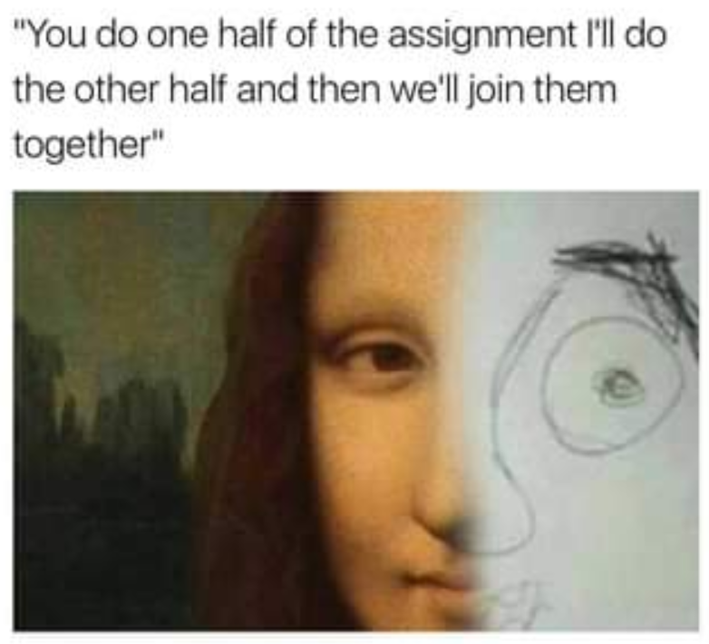

Slide 9
Coordination
Individuals adjusting perspectives, opinions, and work habits.
Find common ground
Understand each other’s roles and responsibilities

Slide 10
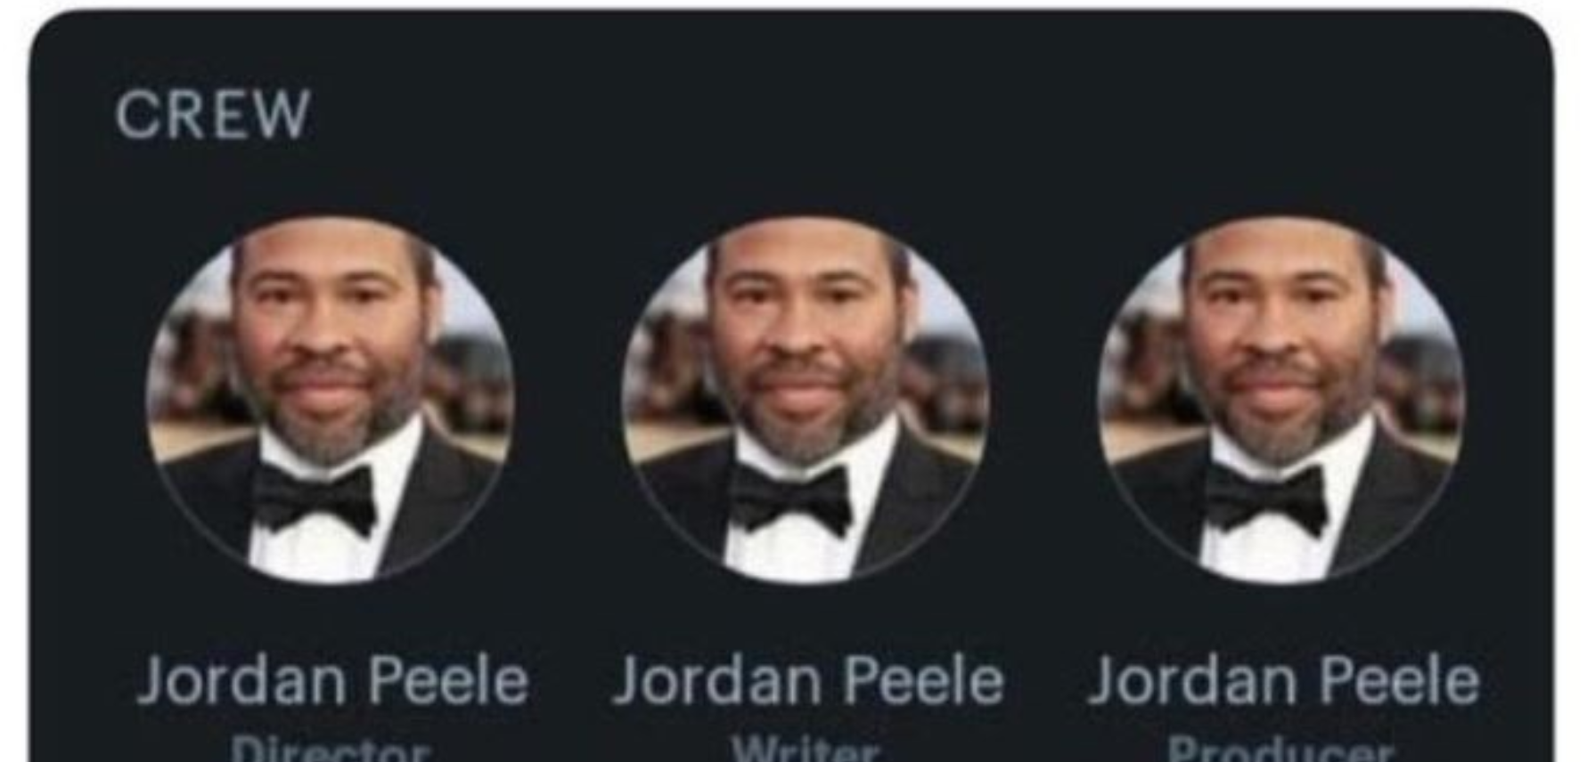

Slide 11

Cross-fertilization
Individuals exchanging knowledge and skills.
Openness
Willing to share expertise, skills, and knowledge
Willing to receive expertise, skills, and knowledge

Slide 12
“There are known knowns; there are things we know we know. We also know there are known unknowns, that is to say we know there are some things we do not know. But there are also unknown unknowns—the ones we don’t know we don’t know… It is the latter category that tends to be the difficult ones.”
- Donald Rumsfeld

Slide 13
What do teachers know about us?
Known knowns | We can fix speech sounds We help kids with academics and social interaction… somehow…
Known unknowns | What exactly does the “language” part of “speech-language pathologist” refer to? What exactly do SLPs do when they pull students?
Unknown unknowns | Written language? Dyslexia? TBI? Executive functions?

Slide 14
What do We know about teachers?
Known knowns | What does this student’s cognitive profile look like?
Known unknowns | What topics are covered in the student’s classroom curriculum? What’s going on in the student’s personal life? Are therapy skills generalizing to the classroom?
Unknown unknowns | BLIND SPOT! Classroom and behavior management? More examples?

Slide 15

Integration
Individuals removing boundaries between themselves.
What kinds of boundaries?
How can we make this work?

Slide 16
What barriers to collaboration do you experience?

Slide 17
Difference in training and service framework
Absence of interdisciplinary culture
Professional hierarchies
Lack of equality
Lack of time
Lack of formal support
Restrictions of setting/location
Professional or social boundaries
Too many students
Poor communication
Poor understanding of each other’s roles

Slide 18
Cooperation
Individuals working together on a joint task.
Barriers
Time
Communication
Hierarchies
Professional or social boundaries
Lack of interdisciplinary culture or formal supports
Restrictions of setting/location
Solutions?
Kill two birds with one stone Mash two potatoes with one fork
Plan your collaboration early, before your schedules get too crazy
Make sure you’re a familiar, friendly face
“Market” your services with demonstrations and word-of-mouth
Get creative with service delivery options

Slide 19
Coordination
Individuals adjusting their perspectives, opinions, and work habits.
Barriers
Communication
Professional or social hierarchies
Lack of equality
Lack of interdisciplinary culture
Solutions?
What compromises can you make, and what is off-limits?
How do teachers perceive you? SLPs in general? What can you do to sway their perception?

Slide 20
Cross-fertilization
Individuals exchanging knowledge and skills.
Barriers
Professional hierarchies
Lack of equality
Differences in training and service framework
Curriculum
Solutions?
How can you communicate the skills/knowledge that the teacher needs? Showing? Telling? Asking the teacher what they need?
What do we need to learn in order to make sure our students can access their classroom curriculum?

Slide 21
How can I collaborate across different service delivery models?

Slide 22
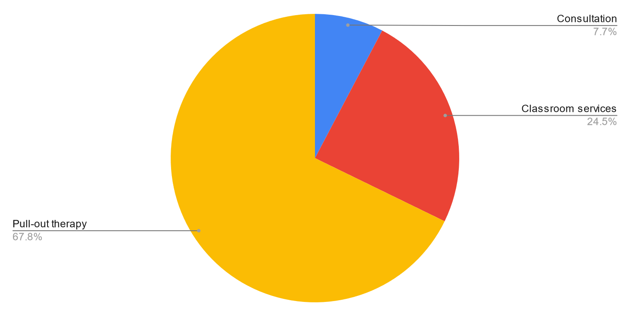
Service delivery models
“Pull-out” services
“Push-in” services
Indirect services

Slide 23
“pull-out” services
Ensure
Ensure that your IEP goals align with functional and meaningful outcomes aligned with classroom needs.
Move
Move your therapy towards contextualization: Decontextualized > Contextualized > Activity-focused
Maintain
Maintain open lines of communication with the teacher, keeping an eye on generalization

Slide 24
“push-in” services
Explore different models of “push-in” services:
Supportive co-teaching: Teacher leads, SLP monitors the whole class and provides targeted support
Parallel teaching: The classroom is split into groups, the teacher instructs one group, and the SLP works with a group that needs modified instruction
Complementary co-teaching: Teacher provides instruction, SLP enhances the instruction (e.g., visuals, examples, implementation of language-supportive strategies)
Team co-teaching: SLP acts as a full extension of the teacher, assisting in planning, teaching, assessment, and shared responsibility for classroom students

Slide 25
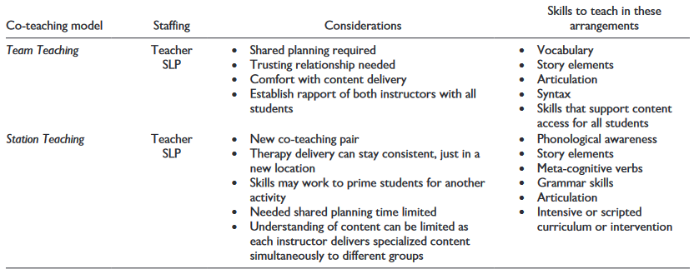
considerations
Zimmerman et al., 2022

Slide 26
Indirect services
Consultation with teachers
Consultation with parents
Suggest and train teacher in instructional strategies
Suggest and train teacher in environmental modifications

Slide 27
what has your collaboration looked like?

Slide 28
References
Send me an email if you need access to any of these articles!
Archibald, L. M. (2017). SLP-educator classroom collaboration: A review to inform reason-based practice. Autism & Developmental Language Impairments, 2
Heisler, L. A., & Thousand, J. S. (2021). A guide to co-teaching for the SLP: A tutorial. Communication Disorders Quarterly, 42(2), 122-127.
Pfeiffer, D. L., Pavelko, S. L., Hahs-Vaughn, D. L., & Dudding, C. C. (2019). A national survey of speech-language pathologists' engagement in interprofessional collaborative practice in schools: Identifying predictive factors and barriers to implementation. Language, Speech, and Hearing Services in Schools, 50(4), 639-655.
Wallace, E. S., Senter, R., Peterson, N., Dunn, K. T., & Chow, J. (2022). How to establish a language-rich environment through a collaborative SLP–teacher partnership. TEACHING Exceptional Children, 54(3), 166-176.
Zimmerman, K. N., Chow, J. C., Majeika, C., & Senter, R. (2022). Applying co-teaching models to enhance partnerships between teachers and speech-language pathologists. Intervention in School and Clinic.

Slide 29
What questions do you have?
Feel free to email me at rrsenter@umd.edu if you have any questions, or if you need a copy of any of the articles mentioned today.
Slides available via QR code or at https://www.reedsenter.com/

